Slide 1
Front End Web Design
For the brave and open hearted women in STEM sitting before me.
By Tali Kuhel
Midreshet Harova, NYU, AppNexus

Slide 2
#1 Tali, what is a website?
Files
HTML (.html), CSS (.css), JavaScript (.js)
Domain name
www.talikuhel.site/ (shameless self promotion)
A host
Dream Host (I should seriously get a commission for this)
Browser
Google Chrome, Safari, (Internet Explorer?!)

Slide 3
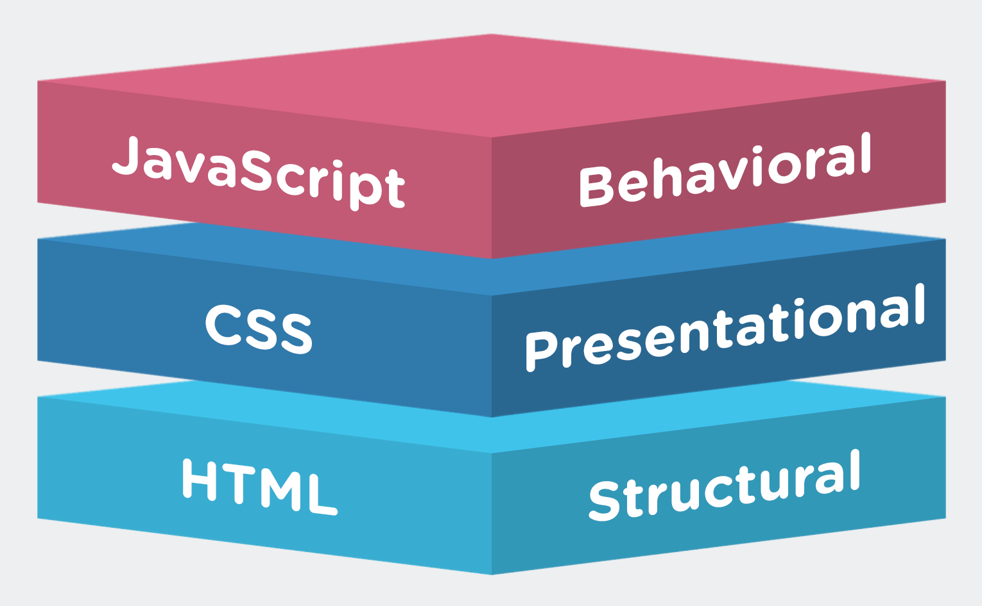
#2.1 “Can you define these terms for us?”
Progressive Enhancement!
Notes:
Progressive enhancement is a design principle. It essentially means that a web developer should make sure that whatever they design should be able to load and function perfectly on the simplest possible browser a user could use. This typically means making sure your site has a barebones HTML and CSS structure that won’t inhibit a user who has disabled javascript. But, it also refers to a user focused design principle that relies on simplicity over adding extra bells and whistles.

Slide 4

#2.2 “Can you define these terms for us?”
Responsive Design!
Notes:
Responsive design means that your code reacts to the screen size of the browser rendering it. That means it stretches to fit desktop, tablet and mobile screens. This can be done simply by always defining image size in percentages of the screen size rather than prefixed pixel amounts.

Slide 5
#2.3 “Can you define these terms for us?”
Mobile First!
1
Notes:
Mobile First is the design principle that defines mobile rendering as the prime concern for a web site. Therefore, designing a mobile product that can literally be stretched out to fit a browser is ideal.
(Pause for general web design terms questions.)

Slide 6

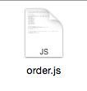
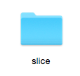
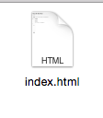

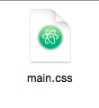
#3 “Can we see some code now.”
First, a word about saving your work:
.html .css .js .php
index.html
lowercase
directories
Notes:
The way you save a file is CRITICAL.
You can write beautiful html code, but the browser will only render it if the object is defined! That is what the “.html”, for example, does.

Slide 7
#4 “Markup Language isn’t code”
<p> </p>
<p> Letters enclosed in tags, between <>, must be lowercase. The browser renders the content enclosed in tags based on the opening and closing tag. The closing paragraph tag must have a backslash.</p>

Slide 8
#5 Barebones HTML web page
<!doctype html>
<html>
<head>
<meta charset="utf-8">
<title></title>
</head>
<body>
</body>
</html>
Notes:
Charset http://www.w3schools.com/TAgs/att_meta_charset.asp

Slide 9
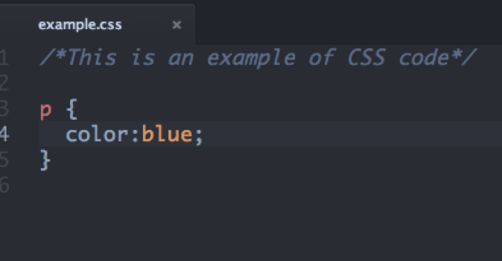
#6 How the style gets in there (CSS)
Points to <p> in html!

Slide 10
#7 Let’s get you started on a web site.
Download and open a text editor
type/paste barebones html code. Save as index.html
Save index.html to a directory with your site’s title
Inside that directory, create a folder named “styles”
In your text editor, open a new document and save it as “styles.css” to your “styles” folder
Link styles in the <head> section of your html page
Try opening it locally!

